Slide 1
Movie Recommendation System
By
Rakesh Kumar Baral
Mtech in Computer Science(DA Specialization)
Roll No: 2064004

Slide 2
What is a Recommended System?
Recommended system produce a ranked list of items an user might show interest based on the previous history of his choices
This kind of system mainly has two major elements USER and ITEM
Showcase personalised content to the user

Slide 3





Content Based Movie recommended system
Recommended Movies
Similar Movies
Content
Lead Artist
Same Director
Popularity

Slide 4







Collaborative Movie Recommended System
Watched and given good rating
Watched and given good rating
Similar Users on the basis of the ratings given to the movies
Recommended movie

Slide 5
DATASETs Used
600DATASET:100,000 ratings from 9,000 movies by 600 users.
943DATASET:100,000 ratings from 943 users on 1682 movies.
Each user has rated at least 20 movies.

Slide 6
600DATASET(Popularity Based Recommended Systems)
Some top review websites maintain a database of reviews and ratings of movies. Exp: IMDB, Rotten Tomatoes
The data can be collected and used to build a popularity based movie recommended system
Recommending the movies as per the rating given by the user will increase their content consumption

Slide 7
600DATASET
Collect all the ratings values in a pivot table having User Vs Movie Title
Correlate the rating series of input movie with the columns of the other movies
Again sort them with the values as per the number of the ratings given
Give the output of similar movies
Sort the values as per the correlation values in descending values

Slide 8
600DATASET
Input Given : (500) Days of Summer (2009)
Recommended Movies:
Correlation number of total Ratings
Title
Pulp Fiction (1994) NaN 55567
Fight Club (1999) NaN 11772
Star Wars: Episode IV - A New Hope (1977)
NaN 6526
León: The Professional (a.k.a. The Professional) (León) (1994)
NaN 4655
2001: A Space Odyssey (1968)
NaN 4469

Slide 9
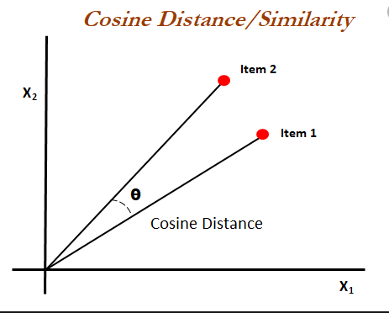
943DATASET
Cosine Similarity:
It is the measure of similarity between two non-zero vectors .It is determined by taking the cosine of the angle between them

Slide 10
943Dataset
Dividing the complete matrix into train and test matrix
Finding the cosine similarity matrix in the training matrix
Function for collaborative filtering(User-User, Item-Item,SVD,PCA)
Predicting the unrated fields
Using the model which is giving the lowest error
Comparing with the test matrix corresponding values and calculating the mean square error for each model

Slide 11
943Dataset(Item-Item iltering)
Arrange the cosine similarity values in the descending order.
In the pivot cosine matrice, only keep the required number items having highest cosine values
Iterating the dot product between the most similar item cosine values to all the movie positions
Ultimately the matrix for all the movie rating prediction is deduced.

Slide 12
943Dataset(User-User Filtering)
Arrange the cosine similarity values in the descending order.
In the pivot cosine matrice, only keep the required number users having highest cosine values
Iterating the dot product between the most similar user cosine values to all the movie positions
Ultimately the matrix for all the movie rating prediction is deduced.

Slide 13
943DATASET(SVD Model Based)
Apply Single Value Decomposition mechanism to decompose the complete cosine matrice into three matrices such as U, Sigma and V.
The dimension we want after the reduction we can pass as a parameter.
By trial and error method we can check ,the least error is coming with dimension 12.

Slide 14
943DATASET
Root Mean Square Error is a formulation used to measure the accuracy of the model.
RMSE of User-User Based Modelling=3.50
RSME of Item-Item Based Modelling=3.74
RSME of SVD Based Modelling=2.83
Hence the SVD model is used in this Movie Recommended System

Slide 15
943DATASET
Give user value =1
Movie recommended:
Before the Rain (1994)
Sudden Death (1995)
Johnny Mnemonic (1995)
Basketball Diaries
The (1995) Fall Time (1995)
Give user Value =100
Movie recommended:
It Takes Two (1995)
Guardian Angel (1994) Cry
the Beloved Country (1995)
Lawnmower Man 2: Beyond Cyberspace (1996)
Powder (1995)
Lamerica (1994)

Slide 16
Areas for Improvement
In the content-based approach, we can take more dimensions for better result
In the collaberative approach,we do have a whole lot of different algorithms we can apply for the perfect result or to minimize the errors
We do have hybrid concept also where we can use both the above pproaches and deep learning to make a perfect recommendation system

Slide 17
Thank You!

